Slide 1
FUNDAMENTALS OF SOFTWARE ENGINEERING
AKSHAYA R
ASSISTANT PROFESSOR

Slide 2
Software Development Life Cycle (SDLC)
Imagine building a house without a blueprint or a pre-defined construction process. It would likely be chaotic, inefficient, and lead to an unpredictable outcome.
The SDLC Model is essentially a blueprint for software development, ensuring a structured and organized approach from conception to completion.
Think of it as a roadmap that guides the entire development process, ensuring a structured and well-defined approach to building high-quality software.

Slide 3
Software Development Life Cycle (SDLC)
Some examples that illustrate the need for an SDLC Model in software development:
Traffic Intersection Without Signals: Imagine a busy intersection without traffic lights or stop signs. Cars would enter from all directions, causing collisions, delays, and frustration. An SDLC Model acts like the traffic signals, defining the order and flow of development tasks to avoid chaos and ensure smooth progress.
Electrical Circuit Without a Schematic: Building an electrical circuit without a schematic diagram can be dangerous and unpredictable. The wrong connections can lead to malfunctions, damage to components, or even safety hazards. An SDLC Model is schematic, outlining the steps and connections (code modules) needed to build a functional and reliable software system.

Slide 4
Software Life Cycle Model
A Software Life Cycle Model, also known as a process model, is a structured framework that describes the phases and processes involved in the development and maintenance of software.
It outlines “a systematic approach to create high-quality software” by defining the tasks and activities required at each stage of the software development life cycle (SDLC).
The primary goal of a life cycle model is to ensure that the software product is developed in a methodical and organized manner, reducing risks and increasing efficiency.

Slide 5
Software Life Cycle Model
For planning, developing, and managing software projects. “Provides a step-by-step approach to software development, ensuring a high-quality, well-defined, and efficient development process.’’
It represents the sequence of stages that a software product goes through from initial conception to its eventual retirement.
The choice of life cycle model can impact the effectiveness and efficiency of the development process.

Slide 6
Key Aspects of Software Life Cycle Models
Structured Approach:
Life cycle models provide a structured approach to software development.
They define the sequence and flow of activities, ensuring that each phase is completed systematically.
This structured process helps manage complexity and enhances project predictability.

Slide 7
Key Aspects of Software Life Cycle Models
Activity Mapping:
Life cycle models map the various activities performed on a software product from its inception to retirement.
Different models organize these activities in different ways, but essential activities are present in all models.
Concurrent Activities:
In many life cycle models, multiple activities can occur simultaneously.
This allows for overlapping tasks, improving efficiency and reducing development time.

Slide 8
Key Aspects of Software Life Cycle Models
Adaptability:
Different life cycle models can be chosen based on the specific needs of a project.
Each model has its strengths and is suited to different types of projects and development environments.
Documentation:
Life cycle models often emphasize documentation at each stage.
Proper documentation ensures that all aspects of the development process are recorded, aiding in maintenance and future development.

Slide 9
Importance of Software Life Cycle Models
Risk Management: By providing a structured approach, life cycle models help identify and mitigate risks early in the development process.
Quality Assurance: They ensure that each phase is completed thoroughly, contributing to the development of high-quality software.
Project Management: Life cycle models help in planning, scheduling, and resource allocation, making it easier to manage software projects.
Communication: They provide a common framework and terminology, facilitating better communication among team members and stakeholders.
Continuous Improvement: Models like the iterative and spiral models emphasize continuous feedback and improvement, leading to better software products over time.

Slide 10
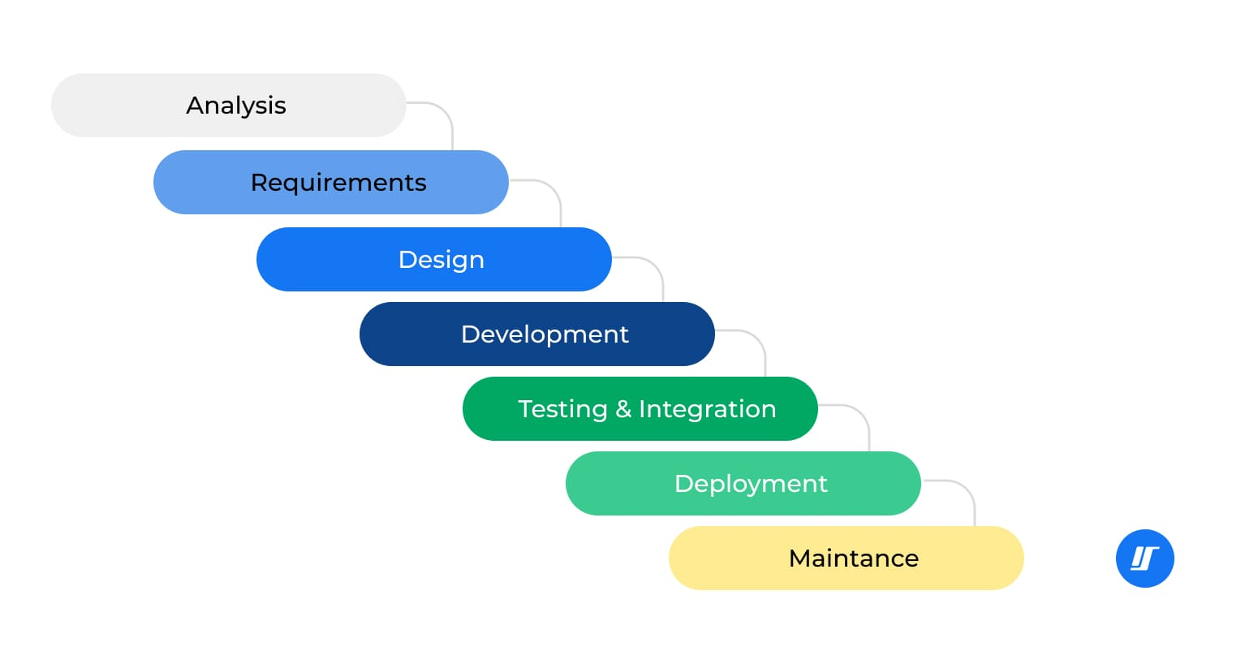
SDLC Phases

Slide 11
COMMON Phases
While specific phases may vary depending on the chosen SDLC model, some general stages include:
Planning & Requirements Gathering: Define project goals, identify user needs, and gather requirements.
Design: Create a blueprint for the software's architecture, functionality, and user interface.
Development: Write the code that brings the software to life.
Testing: Identify and fix bugs and ensure the software meets requirements.
Deployment: Release the software to users.
Maintenance: Fix bugs, provide updates, and address ongoing needs after deployment.

Slide 12
Different Models
Several SDLC models exist, each with its own strengths and weaknesses. Here are a few popular examples:
Waterfall Model: Traditional, sequential approach (good for simple projects with clear requirements).
Agile Model: Iterative and incremental approach (flexible and adaptable to changing requirements).
Iterative Model: Combines elements of Waterfall and Agile (structured with room for revisions).
Spiral Model: Risk-driven approach that emphasizes risk identification (suitable for complex projects).
Prototype Model: Develops a simplified version early to gather feedback and refine requirements.

Slide 13
Classical Waterfall Model
Introduction:
The Waterfall Model is a classical software development methodology that was first introduced by Winston W. Royce in 1970.
Waterfall Model is one of the earliest and most traditional software development life cycle (SDLC) models, characterized by its linear and sequential approach.
This model divides the software development process into distinct phases, each of which must be completed before moving on to the next.
This structured methodology emphasizes thorough documentation and planning, making it straightforward to manage and understand.
The Waterfall Model is especially suited for projects with well-defined requirements and minimal expected changes, providing a clear and predictable development path.

Slide 14
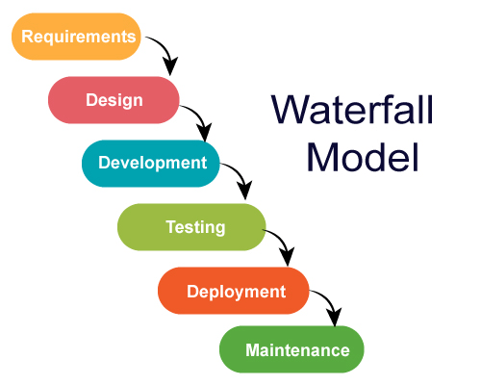
Classical Waterfall Model

Slide 15
Phase 1: Planning & Requirements Gathering
This crucial phase lays the groundwork for the entire project.
Defining Project Goals: Clearly articulate the software's purpose and desired outcomes. What problem are you trying to solve, or what need are you fulfilling?
Identifying Stakeholders: Recognize all parties involved in the project, including users, sponsors, developers, and testers.
Gathering Requirements: Meticulously collect requirements from various stakeholders through interviews, workshops, or document analysis. Ensure requirements are clear, concise, measurable, achievable, relevant, and time-bound (SMART).
Feasibility Study: Assess the technical and business feasibility of the project based on the gathered requirements. Is the project technically achievable within budget and time constraints? Does it align with the organization's goals?
Requirements Documentation: Document all the gathered requirements in a well-defined format, such as a Software Requirements Specification (SRS) document. This serves as the single source of truth for the entire development process.

Slide 16
Phase 2: Design
With a solid foundation of requirements, this phase focuses on creating a detailed blueprint for the software.
Key activities include:
System Architecture Design: Define the overall software architecture, including its components, communication protocols, and data flow.
Module Design: Decompose the software into smaller, manageable modules with well-defined interfaces.
User Interface (UI) Design: Craft the user interface mockups or prototypes that illustrate how users will interact with the software.
Database Design: Design the database schema to store and manage the software's data effectively.

Slide 17
Phase 3: Development (Building the Structure)
Now comes the building phase, where the software comes to life based on the design blueprint. Think of it as constructing the house based on the architectural plans.
Activities in this phase involve:
Coding: Developers write the code for each software module using the chosen programming languages and tools.
Unit Testing: Developers perform unit testing to identify and fix bugs within individual code modules before integration.

Slide 18
Phase 4: Testing (Quality Assurance)
This phase ensures the software meets the documented requirements and functions as intended. Testing activities include:
Unit Testing: Further unit testing might be conducted by dedicated testers to ensure the code modules function correctly in isolation.
Integration Testing: Modules are integrated to test how they interact and function together as a whole system.
System Testing: The entire software system is tested against the documented requirements to ensure it delivers the expected functionalities.
User Acceptance Testing (UAT): Actual users or representatives test the software to provide feedback on its usability, functionality, and overall user experience.

Slide 19
Phase 5: Deployment
Once rigorous testing is complete and the software is deemed functional, it is time to deploy it to the target environment.
Deployment activities may involve:
Packaging: The software is packaged into a format suitable for deployment on the target servers or user devices.
Installation: The software is installed on the target environment, making it accessible to users.
User Training: Users might receive training on how to use the software effectively.

Slide 20
Phase 6: Maintenance
The development process does not end with deployment.
Software requires ongoing maintenance to fix bugs, provide updates, and address evolving needs.
Maintenance activities include:
Bug Fixes: Addressing any bugs or issues reported by users after deployment.
Updates and Enhancements: Providing new features, functionalities, or security patches based on user feedback or changing requirements.
Technical Support: Offering technical support to users who encounter problems or have questions about the software.

Slide 21
Advantages of the Waterfall Model
Simplicity and Clarity: The Waterfall Model is easy to understand and implement due to its linear progression, making it accessible even for teams new to software development.
Detailed Documentation: Emphasizes thorough documentation at each phase, ensuring a clear understanding of requirements, design, and implementation.
Manageability: Well-defined stages and deliverables simplify project management, with clear tasks and timelines for efficient resource allocation and tracking.
Predictability: The structured approach leads to predictable project timelines and costs, beneficial for projects with fixed budgets and deadlines.

Slide 22
DRAWBACKS of the Waterfall Model
Inflexible and Incapable of Adapting to Changes: The Waterfall Model's rigidity makes it difficult to accommodate changes in requirements after a phase is completed. This can be problematic for projects with evolving needs or unclear functionalities. Introducing changes later in the development cycle can be expensive and time-consuming.
High Risk of Errors Due to Late Testing: Since testing happens later in the development lifecycle under the Waterfall Model, fixing bugs discovered during testing can be more complex and expensive.
Not Ideal for Complex Projects: The Waterfall Model can struggle with highly complex projects with intricate functionalities or constantly changing requirements. The inflexibility of the model might hinder the development process for such projects.

Slide 23
Iterative Waterfall Model
In real-world software development projects, the classical waterfall model often can be challenging to implement effectively.
The iterative waterfall model addresses these by incorporating necessary adjustments to enhance its practical usability.
While closely resembling the traditional waterfall model, the iterative version introduces specific changes aimed at improving the efficiency of software development process.

Slide 24
Iterative Waterfall Model
The Iterative Waterfall Model is a software development approach that combines the sequential steps of the traditional Waterfall Model with the flexibility of iterative design.
It allows for improvements and changes to be made at each stage of the development process, instead of waiting until the end of the project.
The iterative waterfall model provides feedback paths from every phase to its preceding phases, which is the main difference from the classical waterfall model.

Slide 25
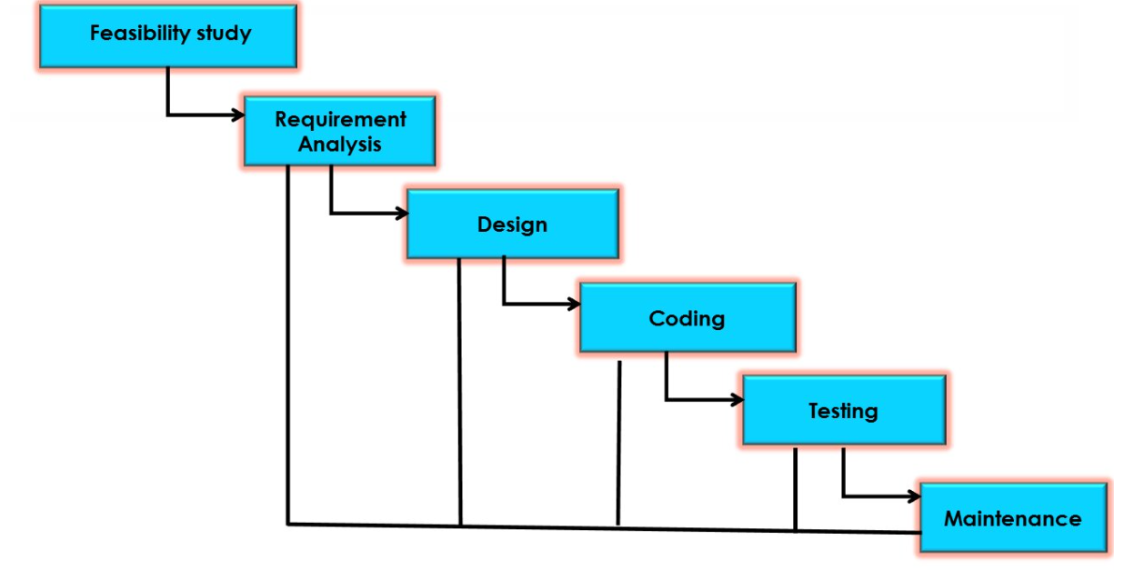
Iterative Waterfall Model

Slide 26
Iterative Waterfall Model
The iterative model typically consists of the following stages:
Requirements Gathering: Initial requirements are gathered from stakeholders.
System Design: A preliminary design of the system architecture and modules is created based on gathered requirements.
Implementation: Development of the system or software begins based on the design.
Testing: Each iteration undergoes testing to identify and fix defects.
Evaluation: Stakeholders evaluate the current iteration to assess its functionality and identify necessary improvements.

Slide 27
Iterative Waterfall Model
Feedback: Feedback from stakeholders and testing informs refinements and adjustments for subsequent iterations.
Iteration: Steps two through six are repeated iteratively until the software meets the desired quality and functionality criteria.
Deployment: The final iteration or release of the software is deployed after comprehensive testing and validation.
Throughout the iterative process, each cycle allows for adjustments and improvements based on feedback, ensuring that the software evolves to better meet user needs and project requirements.

Slide 28
Iterative Waterfall Model - APPLICATIONS
Startups and MVPs: Startups often adopt iterative methodologies to develop Minimum Viable Products (MVPs), allowing them to launch quickly, gather user feedback, and iterate based on market response and investor input.
Web Development: Web development projects frequently employ iterative approaches to build and enhance websites incrementally based on user interaction data and business requirements.
Game Development: Game developers use iterative cycles to create prototypes, test gameplay mechanics, and refine graphics and user interfaces based on player feedback before releasing the final version.
Product Development: Companies manufacturing physical products utilize iterative processes to design, prototype, test, and refine products based on market feedback and manufacturing constraints.

Slide 29
Iterative Waterfall Model - APPLICATIONS
Automotive and IoT Solutions: Development of automotive software systems and Internet of Things (IoT) devices benefits from iterative approaches to integrate new features, improve connectivity, and enhance user experience.
E-commerce Platforms: E-commerce companies adopt iterative development to optimize website functionality, enhance user interface design, and integrate new payment and shipping features based on customer behavior and market trends.
Mobile App Development: Companies developing mobile applications often use iterative models to release initial versions quickly, gather user feedback, and continuously improve features and performance.

Slide 30
choosing the right SDLC model
The key to a successful software development project is finding the perfect fit.
Different SDLC models cater to various project characteristics like size, complexity, team structure, and risk tolerance. By understanding the strengths and weaknesses of each model, you can choose the approach that best aligns with your project's specific needs.
Size:
Refers to the overall scope and scale of the software project.
Larger projects involve more features, functionalities, and data, requiring a more complex development process.
Smaller projects might have a well-defined scope and limited features, making them suitable for simpler SDLC models.

Slide 31
choosing the right SDLC model
Complexity:
Defines the level of difficulty associated with the project's functionalities and technical requirements.
Highly complex projects might involve novel technologies, intricate integrations, or unclear functionalities.
Simpler projects have well-understood technologies and straightforward functionalities.

Slide 32
choosing the right SDLC model
Team Structure:
Refers to the composition and expertise of the development team.
Larger teams with diverse skillsets might benefit from a more structured model like Waterfall, while smaller or more homogenous teams might thrive with Agile methodologies.
Risk Tolerance: Indicates the team's and project's capacity to handle unexpected challenges or changing requirements.
Projects with low risk tolerance require a more controlled and disciplined approach like Waterfall, where changes are minimized.
Projects with higher risk tolerance, such as those with evolving requirements, might be suited for Agile methodologies that embrace adaptability.

Slide 33
evolutionary model
Evolutionary models in software engineering are iterative and incremental approaches that allow for the development of software systems through a series of iterations or releases. These models emphasize adaptability and flexibility, allowing for changes to be made throughout the development process.

Slide 34
evolutionary model
Core Idea: Break it Down, Build it Up
This model emphasizes iterative development, meaning you break down the project into smaller, manageable chunks. Each chunk focuses on delivering a core functionality in a working version of the software. Then, you gather feedback and use it to refine and add features in subsequent iterations.

Slide 35
evolutionary model
The Evolutionary Model is a paradigm of software development that emphasizes gradual development through iterative cycles.
Unlike traditional models that require comprehensive requirements at the beginning, this model allows for the development of software in manageable increments.
In the evolutionary model, software is developed and released in a series of versions, each based on previous iterations' feedback. This method is particularly effective in scenarios where requirements cannot be clearly defined at the outset or are expected to change over time.

Slide 36
evolutionary model
The model operates on two fundamental principles: iterative development and user feedback.
Iterative development means breaking down the software project into smaller, more manageable parts, each undergoing its planning, design, coding, and testing cycle.
User feedback plays a pivotal role in this model.
After each iteration, the end-users evaluate the software, and their feedback is used to inform the next cycle of development.
This continuous loop of development and feedback ensures that the final product aligns more with the user’s needs and expectations.

Slide 37
Evolutionary vs. Traditional Models
Traditional software development models, like the waterfall model, follow a linear, sequential approach.
Each phase (requirements, design, development, testing, deployment) is completed in its entirety before moving on to the next. This approach offers predictability but lacks flexibility.
Evolutionary models, on the other hand, embrace an iterative and incremental approach.
Development occurs in smaller cycles or iterations. Each iteration focuses on delivering a functional subset of the overall system functionality.

Slide 38
Evolutionary vs. Traditional Models
Development is done in small increments, with each iteration building upon the previous one.
This allows for flexibility and adaptability, as changes can be made and feedback can be incorporated throughout the development process.
Additionally, evolutionary models prioritize customer collaboration and feedback, ensuring that the final product meets their needs and expectations. This is in contrast to traditional models, which often have limited customer involvement until the final stages of development.
Overall, evolutionary models offer a more flexible, adaptive, and customer-centric approach to software development.

Slide 39
CHARACTERISTICS of evolutionary model
1. Iterative and Incremental Development: Each iteration, or cycle, results in a potentially deployable product increment. This iterative process allows for frequent reassessment and adaptation.
2. Active User Involvement
3. Flexibility and Adaptability: Capable of accommodating changes at any stage of the development process.
3. Flexibility and Adaptability: Capable of accommodating changes at any stage of the development process.
4. Risk Management : Through its iterative nature, by handling the most critical or uncertain aspects of the project in the early stages, it reduces the potential for large-scale failures.

Slide 40
CHARACTERISTICS of evolutionary model
5. Focus on Functional Components: Instead of delivering the entire software in one go, the evolutionary model focuses on building and improving individual functional components. This approach allows for a more manageable and gradual enhancement of the software.
6. Continuous Testing and Integration:
Since development is done in increments, testing and integration are also continuous processes. This ensures that issues are identified and resolved promptly, maintaining the overall quality of the software.

Slide 41
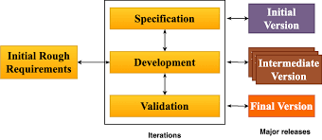
Evolutionary DEVELOPMENT OF Software DEVELOPMENT

Slide 42
Types of Evolutionary Models in Software Engineering
The three main types of evolutionary models are:
Prototyping model
Spiral model
Concurrent model

Slide 43
PROTOTYPING model
The Prototype Model is a software development methodology where a prototype (an early approximation of a final product) is built, tested, and then reworked until an acceptable prototype is achieved.
This model is particularly useful for projects where the requirements are not well understood at the beginning or when users need to interact with a preliminary version to better understand their needs.
It allows for early user feedback and iterative refinement of the requirements and the design.

Slide 44
PROTOTYPING model
The prototype model necessitates that a working prototype of the system be developed before the actual software is created.
A prototype is a toy implementation of the system.
A prototype usually turns out to be a very crude version of the actual system, possible exhibiting limited functional capabilities, low reliability, and inefficient performance as compared to actual software.
Frequently, clients have only a general idea of their expectations for the software product.
In situations where detailed information about system inputs, processing requirements, and output specifications is lacking, the prototyping model proves to be useful.

Slide 45
Why Prototyping Model in Software Engineering is Important?
Prototype models are crucial in software engineering for several reasons.
Early Stakeholder Feedback: Facilitates early involvement and feedback from stakeholders, enabling the identification of design flaws, feature gaps, and areas for improvement, thereby reducing the likelihood of costly revisions in later development stages.
Enhanced Communication: Serves as a tangible reference for discussions between developers, clients, and users, ensuring a mutual understanding of requirements and expectations, which helps align the final product with stakeholder needs.
Risk Mitigation: Allows for experimentation with various design approaches, technologies, and architectural choices, thereby minimizing the risk of resource allocation to suboptimal solutions and improving the overall robustness of the final system.

Slide 46
When to Use the Prototyping Model??
Unclear Requirements: When requirements are not well-understood or are likely to change during development.
User Interface Focus: When the user interface is a critical component and needs thorough validation.
Complex Systems: When the system being developed is complex and requires frequent interaction with end-users to ensure correctness.

Slide 47
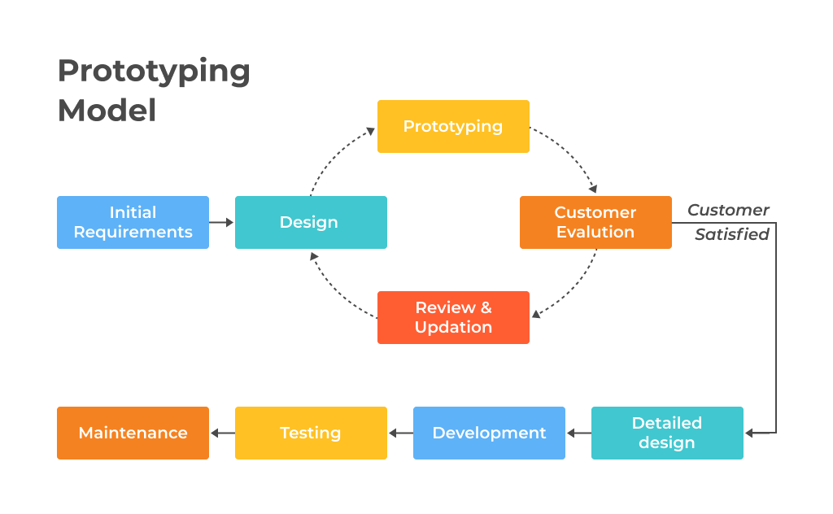

Slide 48
Steps in the Prototyping Model
This approach includes the following components:
Basic requirements identification
Initial prototype development
Initial prototype review
Revision and updating

Slide 49
Steps in the Prototyping Model
1. Requirement Gathering and Analysis: Initial requirements are gathered from stakeholders.
“These requirements are not detailed and are used to build the prototype.”
2. Quick Design: A preliminary design is created based on the initial requirements. This design focuses on creating a prototype with only the essential features.
3. Build Prototype: A working prototype is developed quickly. The prototype is a scaled-down version of the final system, incorporating the main functionalities but often lacking full functionality.
4. User Evaluation: Users interact with the prototype, providing feedback on its functionality, usability, and overall design.

Slide 50
Steps in the Prototyping Model
5. Refinement: Based on user feedback, the prototype is refined, and changes are made to better meet user requirements. This cycle of feedback and refinement continues until the prototype meets the users' expectations.
6. Engineering Product: Once the prototype is accepted, the actual system is developed using a standard software development methodology, incorporating all the features and improvements identified during the prototyping phase.
7. Implementation and Maintenance: The final system is implemented and put into use. Ongoing maintenance is performed to address any issues and implement further enhancements as needed.

Slide 51
USE CASES
Designing a new website layout: Before investing in a complete website redesign, a prototype can help test different layouts and navigation structures with target users. This ensures the final design is user-friendly and achieves desired goals.
Creating a new marketing campaign: Prototyping can be used to test different marketing materials like landing pages or social media ads. By getting user feedback on various versions, you can optimize the campaign for better engagement and conversion rates.

Slide 52
USE CASES
Developing a new educational tool: Educators can use prototypes to test different learning activities and assess student comprehension. This allows for refining the content and delivery method before deploying the final educational tool in classrooms.
Validating a new product idea: If you have a novel product concept but are unsure of its market potential, a prototype can help gauge user interest. By creating a basic prototype and showing it to potential customers, you can gather valuable feedback and decide whether to pursue the product further.

Slide 53
pros and cons
pros
A high degree of user involvement
Time and cost reduction
More user feedback equals better adjusting
Easy identification of difficult companies at early stages

Slide 54
pros and cons
Cons:
High dependency on a prototype
It depends on user experience, meaning they can confuse prototypes with the end product
Changing the scope of the product can boost complexity
Without proper monitoring, building prototypes can be much costlier than planned.

Slide 55
types of prototyping models:
Common types of prototyping models:
Rapid Throwaway Prototyping
Evolutionary Prototyping
Incremental Prototyping
Extreme Prototyping (Rapid Prototyping)

Slide 56
Rapid Throwaway Prototyping
This method uses very little effort and minimum requirement gathering to build a quick prototype to demonstrate an initial image of how the requirements will look visually.
The customer's feedback influences the changes, and the prototype is built again until the requirements are baselined.
This approach will discard a developed prototype and it will not be included in the final accepted prototype. This technique effectively brainstorms ideas and receives immediate feedback on consumer requirements.

Slide 57
Evolutionary Prototyping
The prototype is improved incrementally depending on customer feedback until it is eventually accepted. It allows us to save both time and effort. This is because creating a prototype from scratch for each process interaction might sometimes be extremely unpleasant.
This concept is useful for a project that involves the usage of unknown new technology. It is also employed in complex projects where each functionality must be tested only once.

Slide 58
Incremental Prototyping
The final product is split into small prototypes and produced separately in incremental prototyping.
The several prototypes are eventually combined into a single product.
This strategy helps shorten the feedback time between the user and the application development team.
In addition, the time interval between the project's inception and delivery is reduced because all system parts are prototyped and tested in parallel.

Slide 59
Extreme Prototyping
The web development industry makes extensive use of extreme prototyping. This paradigm is divided into three stages:
First, an HTML prototype with all of the existing pages is displayed.
A prototype services layer is then used to mimic data processing.
Finally, the services are implemented and integrated into the final prototype.
This method is known as Extreme Prototyping because of the second phase of the process, in which a completely functional UI is created with minimal care for the actual services.

Slide 60
Spiral Model
The Spiral Model is a significant Software Development Life Cycle (SDLC) model
The Spiral Model is a combination of the waterfall model and the iterative model. It provides support for Risk Handling.
The Spiral Model was first proposed by Barry Boehm.
This model features a systematic and iterative approach to software development, visually represented as a spiral with multiple loops.
The number of loops in the spiral varies depending on the project, with each loop representing a phase of the software development process.

Slide 61
Spiral Model
The exact number of loops of the spiral is unknown and can vary from project to project.
The number of phases required to develop a product using the Spiral Model can be adjusted by the project manager based on project risks. As the project manager determines the number of phases dynamically, they play a crucial role in the development process.
The model is structured around a spiral concept, where each iteration represents a complete software development cycle, encompassing requirements gathering and analysis, design, implementation, testing, and maintenance.

Slide 62
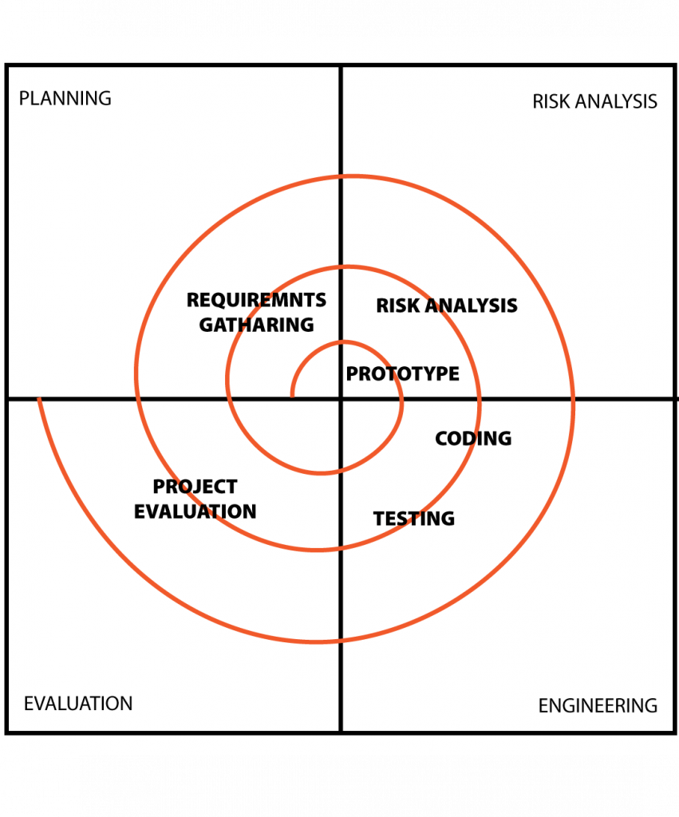
Phases of Spiral Model

Slide 63
Phases of Spiral Model
Planning: The initial phase of the Spiral Model involves planning, where the project's scope is defined and a plan is developed for the subsequent iteration of the spiral.
Risk Analysis: During the risk analysis phase, project risks are identified and assessed.
Engineering: In the engineering phase, the software is developed according to the requirements gathered from the previous iteration.
Evaluation: The evaluation phase assesses the software to ensure it meets customer requirements and maintains high quality.
Planning: The next iteration of the spiral begins with a new planning phase, based on the results of the evaluation.

Slide 64
When to choose Spiral Model
A complex and large-scale project with constantly evolving requirements or an unclear overall scope.
The project has a high degree of risk or uncertainty. The spiral model's focus on risk identification, assessment, and mitigation helps proactively address potential problems.
Frequent software releases are important. The spiral model allows for delivering functional parts in stages, ideal for getting an MVP (minimum viable product) out quickly and gathering early user feedback.
Requirements are unclear or likely to change.
Early user feedback is crucial. The spiral model integrates user involvement at each stage, ensuring the final product aligns with user expectations.

Slide 65
Strengths of The Spiral Model
Ideal for large, risky projects.
Strong risk management focus.
Continuous customer involvement.
Flexible to accommodate changes.
Early product delivery.

Slide 66
WEAKNESSES of The Spiral Model
It can be more complex and costly to implement than other SDLC models, especially for smaller projects.
The success of the project relies heavily on accurate risk assessment, which requires expertise.
Due to the iterative nature, estimating project timelines can be challenging.
Potential for Endless Spirals
Requires Highly Skilled Resources - Effective implementation demands a team with strong risk analysis and management skills.

Slide 67
V-model
V-model is named after its shape, which resembles the letter “V.”
In the V-model, we divide the software development life cycle into phases and each phase is associated with a corresponding testing phase.
The left-hand side of the V represents the verification phase while the right-hand side represents the validation phase.
The V Model, also known as the Verification and Validation model, is a software development process that is an extension of the waterfall model.

Slide 68
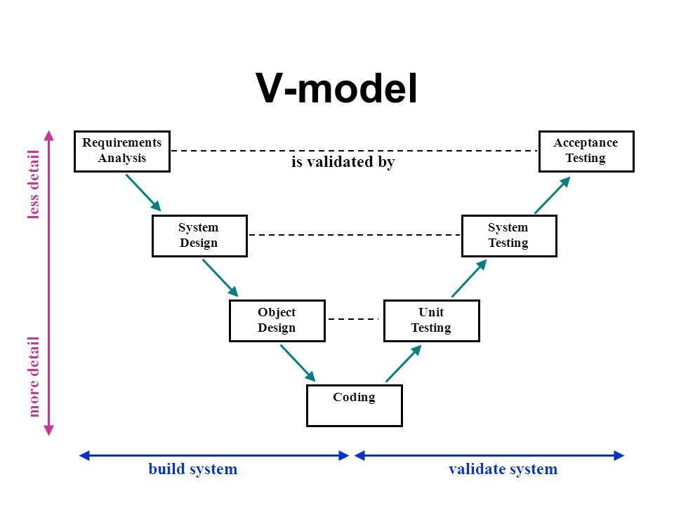

Slide 69
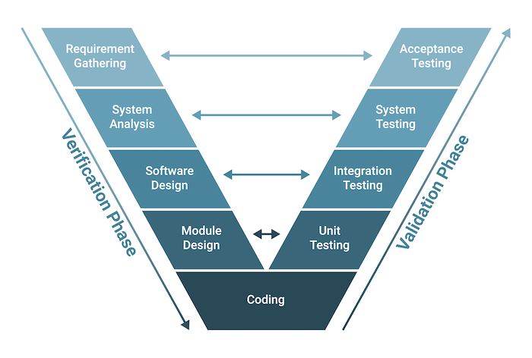

Slide 70
V-model PHASES
Verification Phase (Left side of the V)
Requirement Analysis: Gather and document customer requirements.
System Design: Create overall system architecture.
Architectural Design: Design system components and interfaces.
Module Design: Design individual modules.
Development Phase
Coding: Implement the designed modules.

Slide 71
V-model PHASES
Validation Phase (Right side of the V)
Unit Testing: Testing individual program components.
Integration Testing: Testing how different program components work together.
System Testing: Testing the entire software system as a whole.
Acceptance Testing: Ensuring the software meets the customer's needs and requirements.

Slide 72
V-model PHASES
Validation Phase (Right side of the V)
Unit Testing: Testing individual program components.
Integration Testing: Testing how different program components work together.
System Testing: Testing the entire software system as a whole.
Acceptance Testing: Ensuring the software meets the customer's needs and requirements.

Slide 73
AGILE MODEL
The Agile Model is an iterative and incremental approach to software development.
It prioritizes flexibility, customer collaboration, and rapid delivery of functional software.
Agile methodologies aim for adaptive planning, evolutionary development, early delivery, and continuous improvement.
By prioritizing flexibility and efficiency, Agile aims to deliver projects swiftly.
This is achieved by tailoring processes to specific project needs and eliminating unnecessary steps.
While sharing common principles, Agile methodologies vary in their specific implementation.

Slide 74
AGILE MODEL
The Agile Model is an iterative and incremental approach to software development.
It prioritizes flexibility, customer collaboration, and rapid delivery of functional software.
Agile methodologies aim for adaptive planning, evolutionary development, early delivery, and continuous improvement.
By prioritizing flexibility and efficiency, Agile aims to deliver projects swiftly.
This is achieved by tailoring processes to specific project needs and eliminating unnecessary steps.
While sharing common principles, Agile methodologies vary in their specific implementation.

